Slide 1
Welcome Parents
Skyward Parent Access Workshop

Slide 2
Today’s Agenda
Today’s Meet
Accessing and Logging into Skyward Family Access
Dashboard
Gradebook
Schedule
Skylert
Resources
Worktime
Survey/Feedback

Slide 3
Today’s Meet
Please feel free to collaborate using Today’s Meet at the following link.
https://todaysmeet.com/Skyward_Parent_Access
Questions/Concerns/Frustrations?

Slide 5
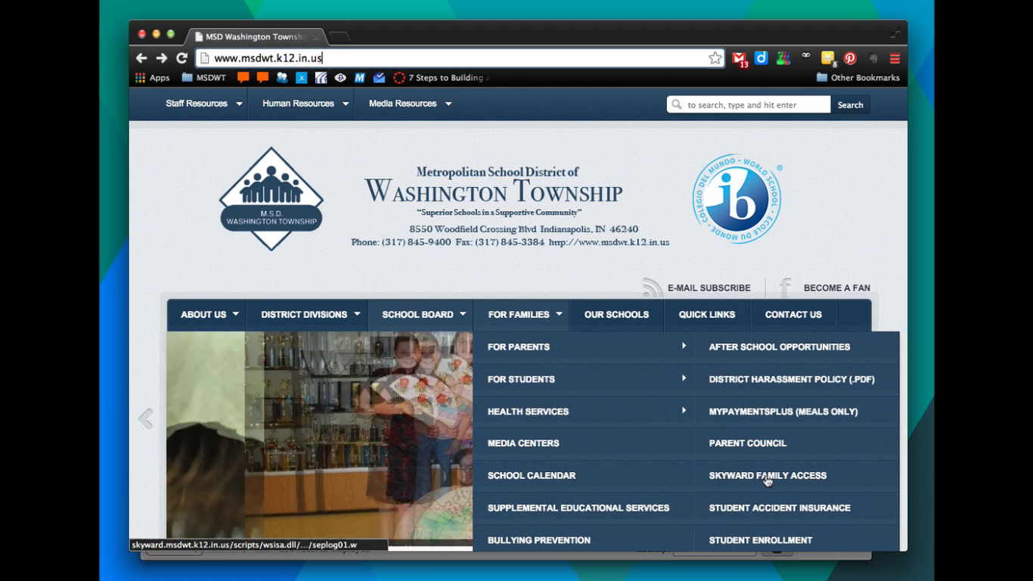

Slide 6
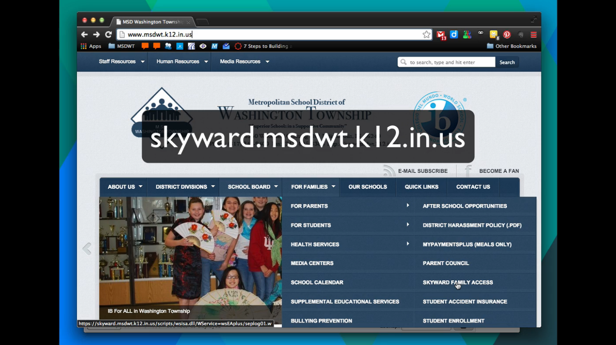

Slide 7
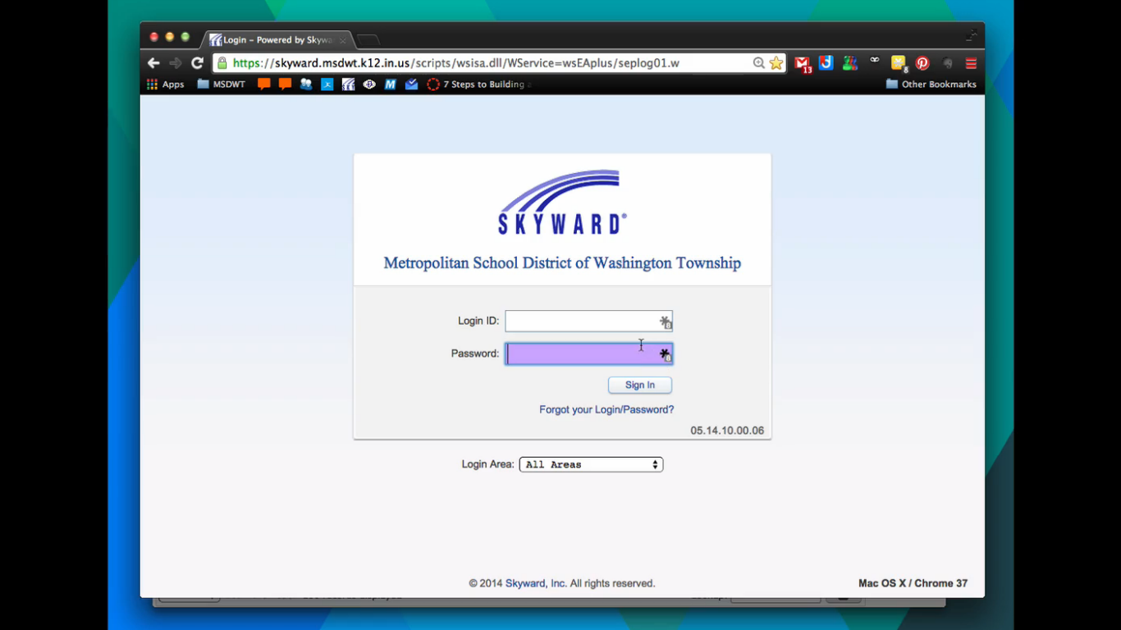

Slide 8
Skyward Parent Access
Understanding the dashboard

Slide 9
Skyward Parent Access Current Options
Home (Dashboard Main Screen)
Gradebook (Access Student Grades)
Student Info (Student and Parent Contact Info, Bus, Homeroom, Advisor, etc.)
Schedule (Students daily schedule)
Fee Management (History, Balance, Payment Options)
Academic History (Grades throughout year)
Portfolio (Report Cards)
Skylert (School and District Alerts)
Login History (Log in timeline)

Slide 10
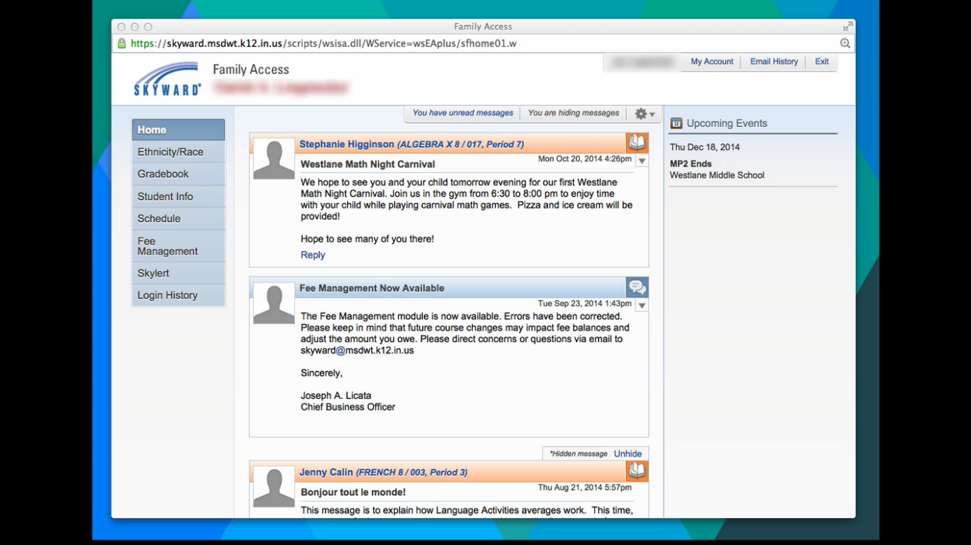

Slide 11
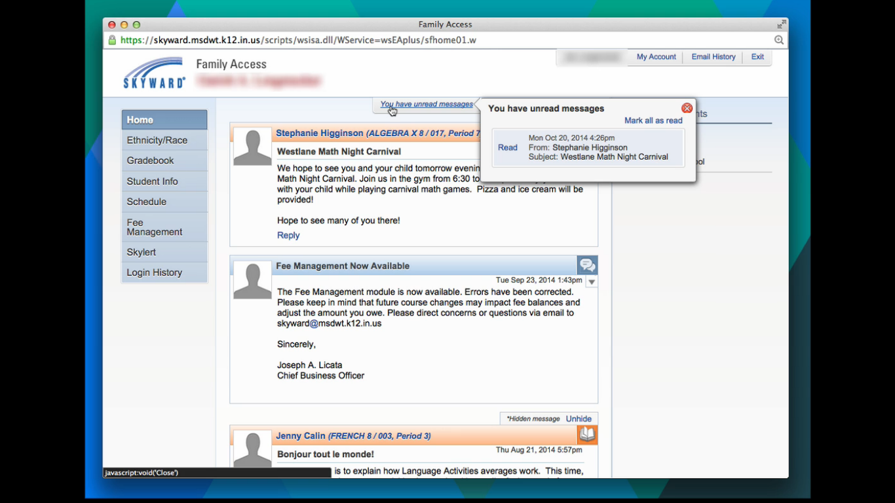

Slide 12
Skyward Parent Access
Understanding the gradebook

Slide 13
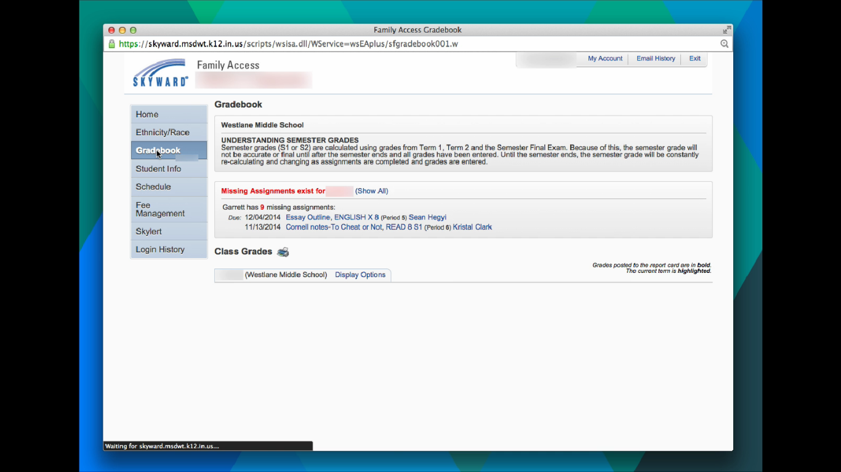

Slide 14
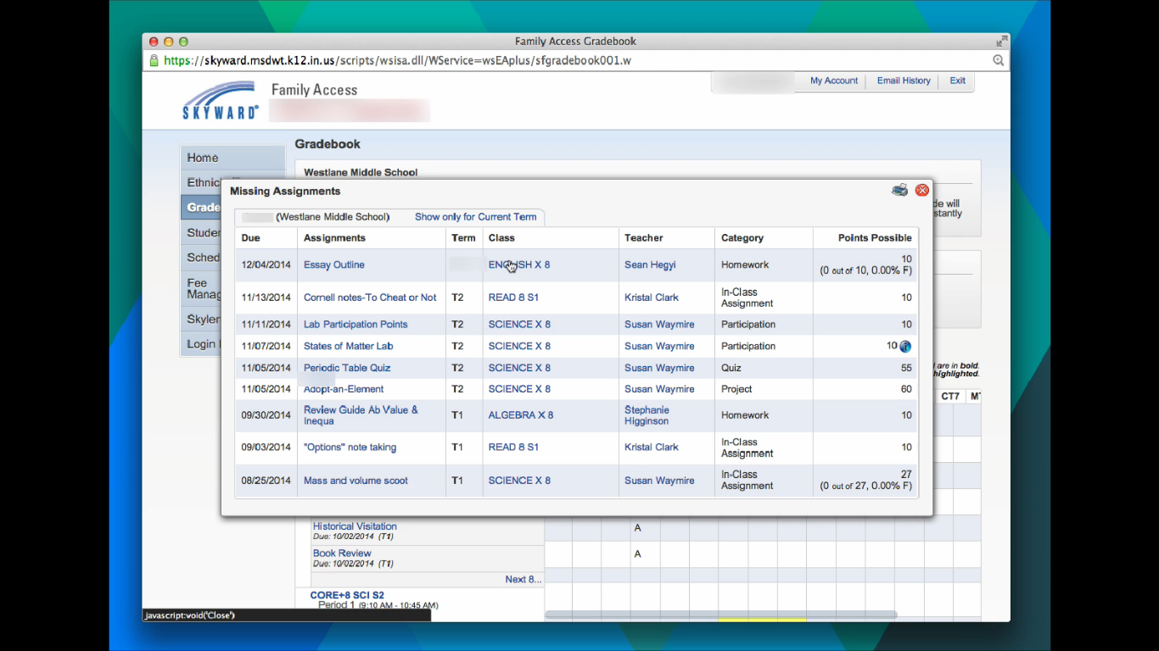

Slide 15
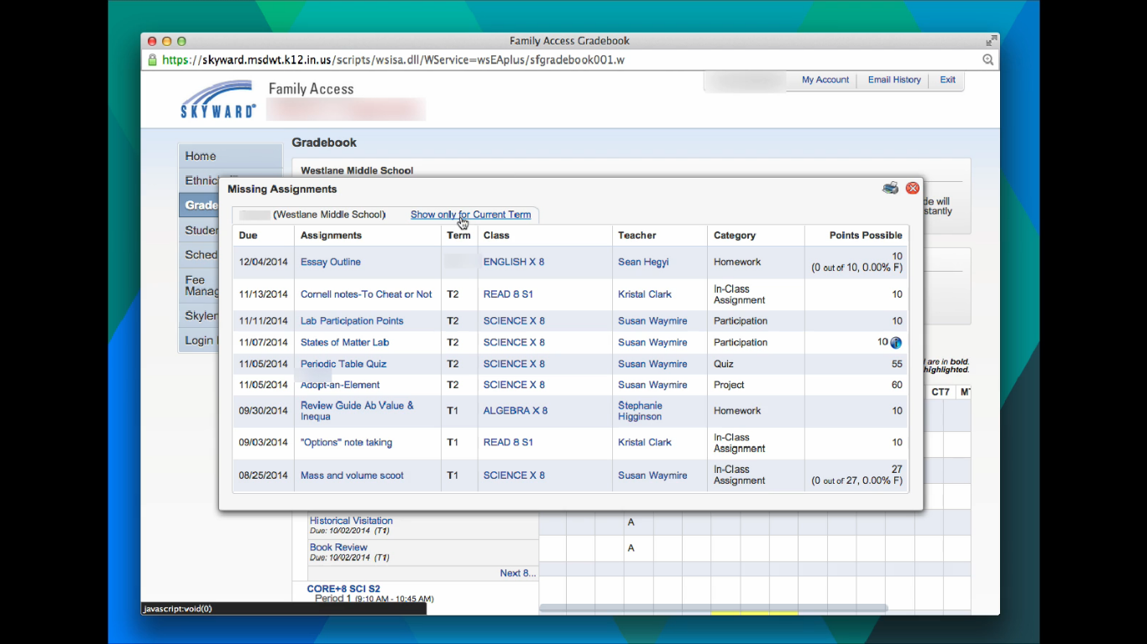

Slide 16
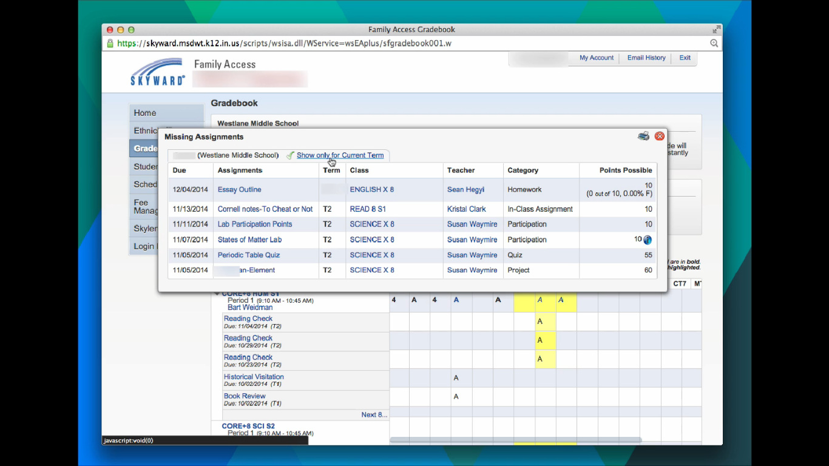

Slide 17
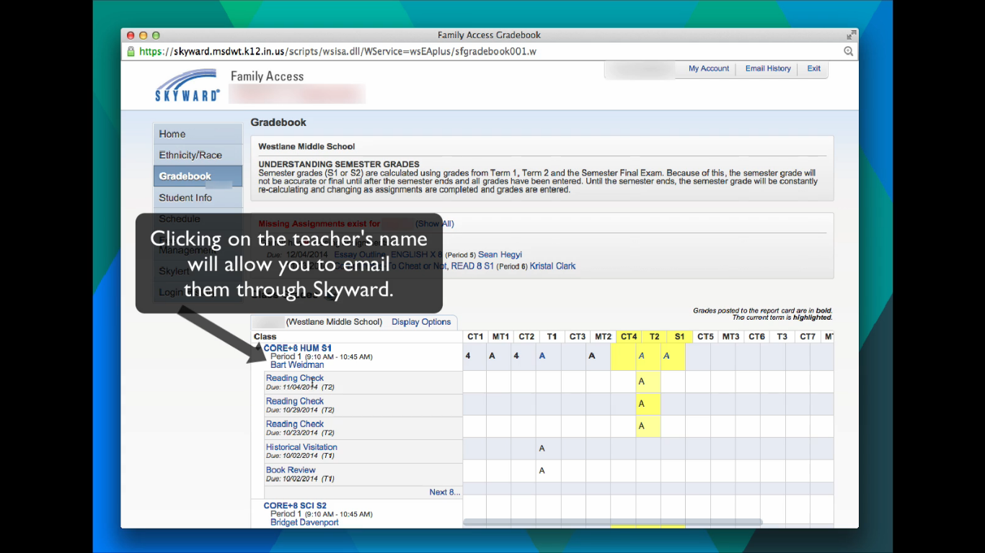

Slide 18
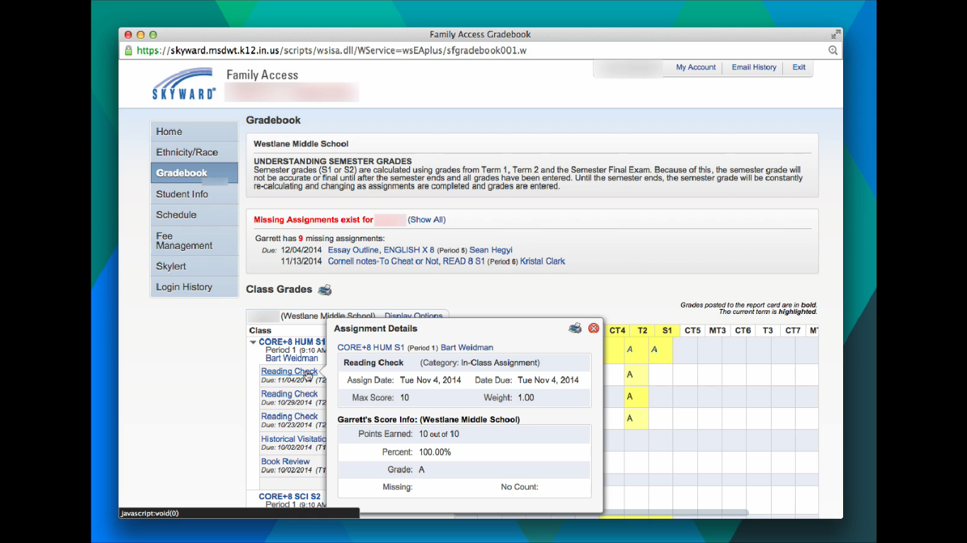

Slide 19
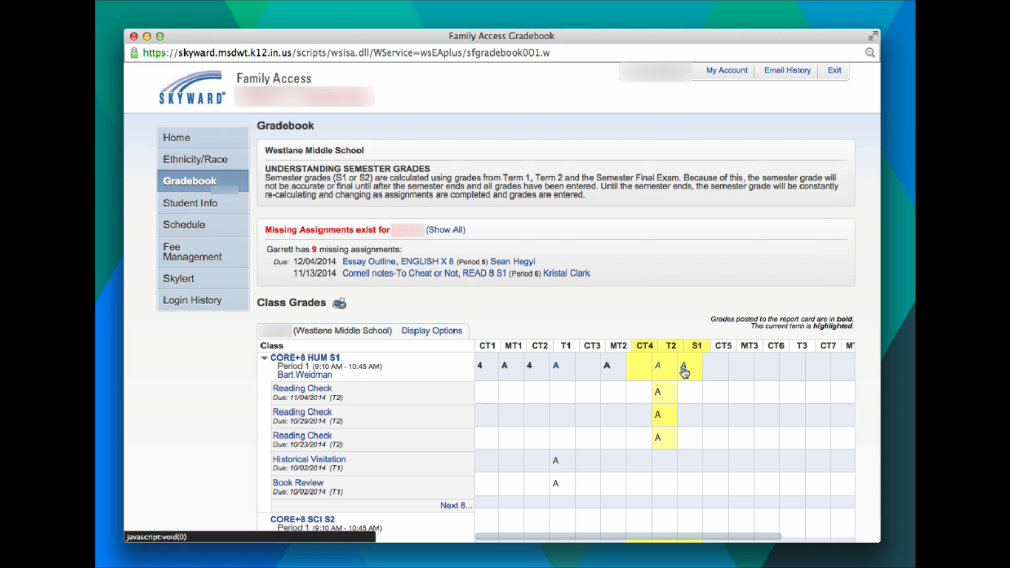

Slide 20
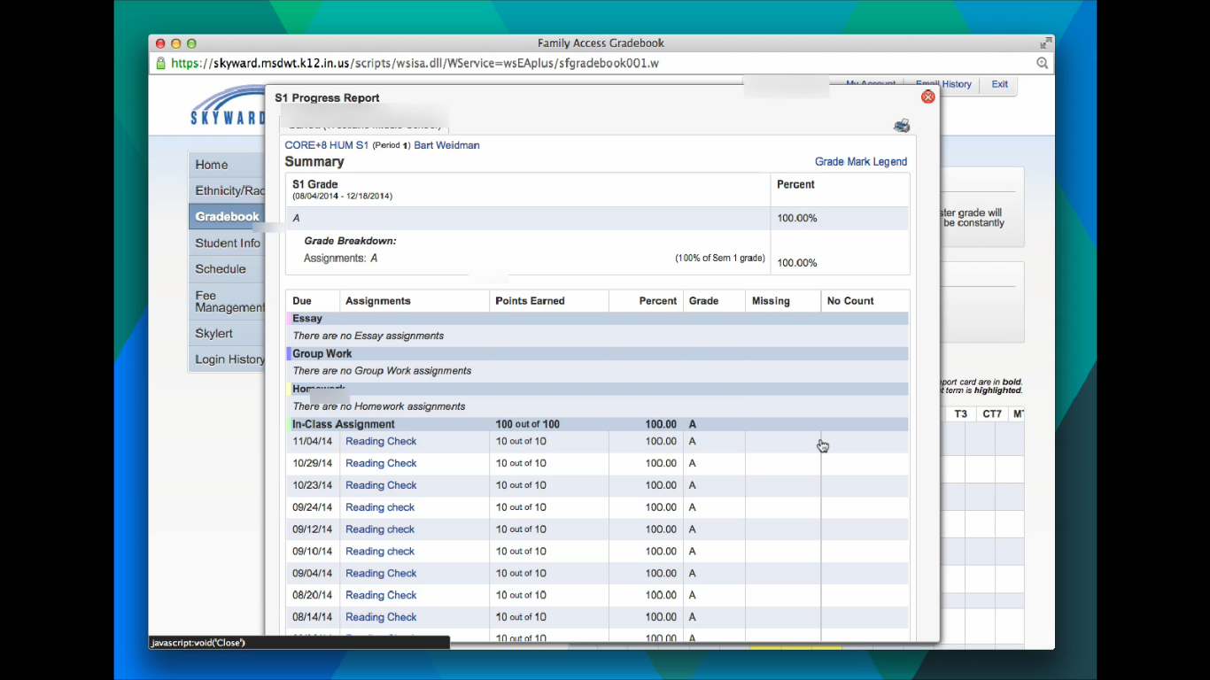

Slide 21
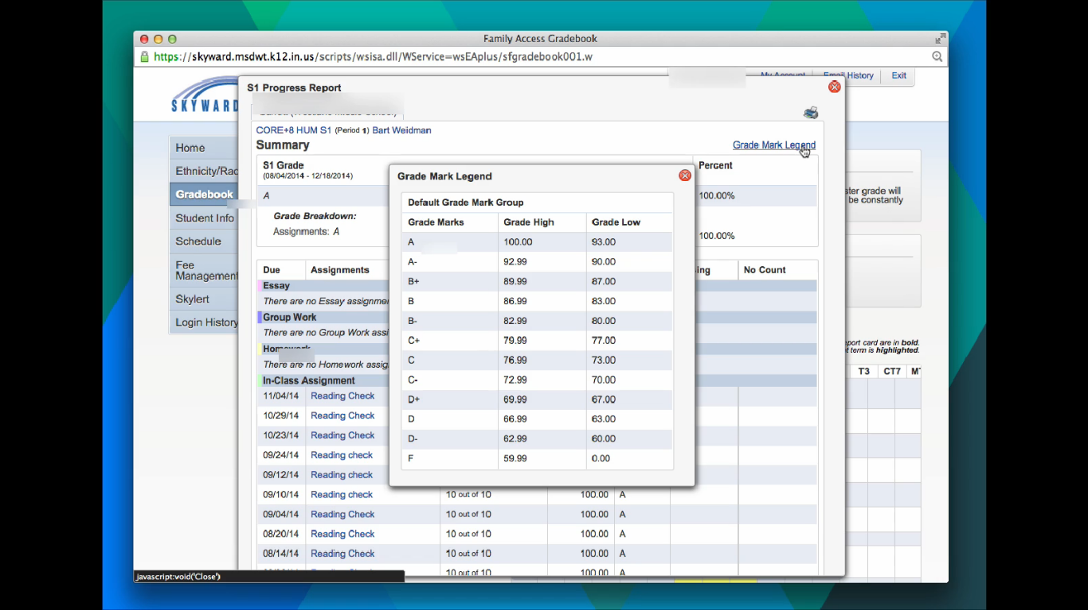

Slide 22
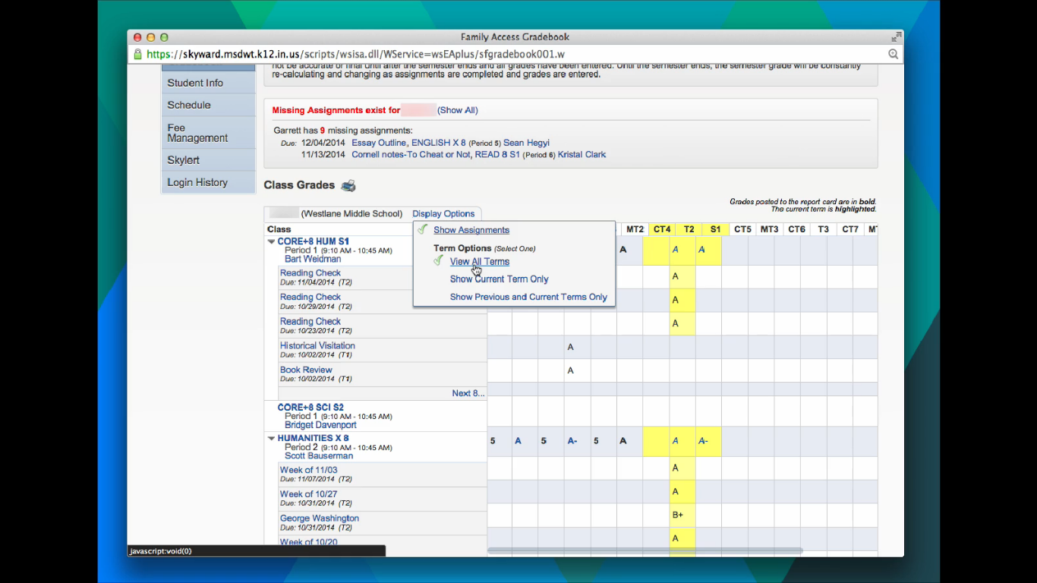

Slide 23
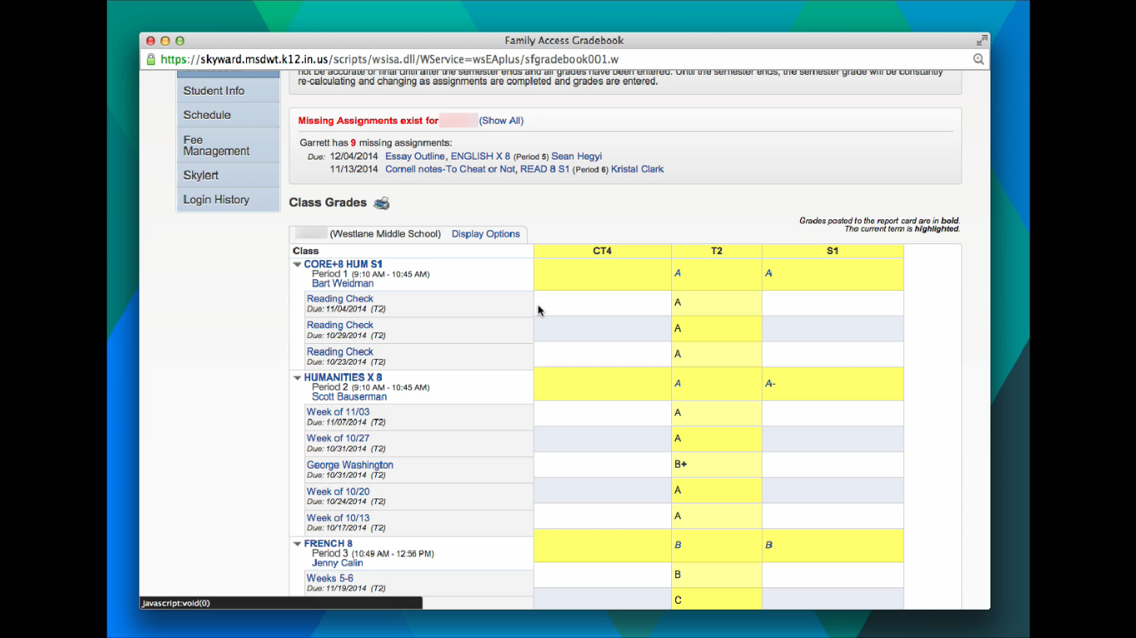

Slide 24
Skyward Parent Access
Understanding schedules

Slide 25
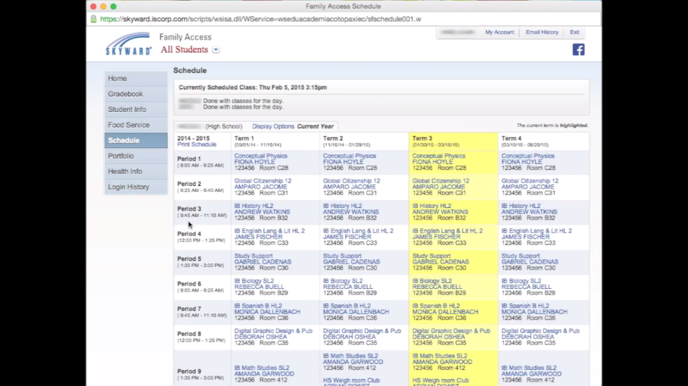

Slide 26
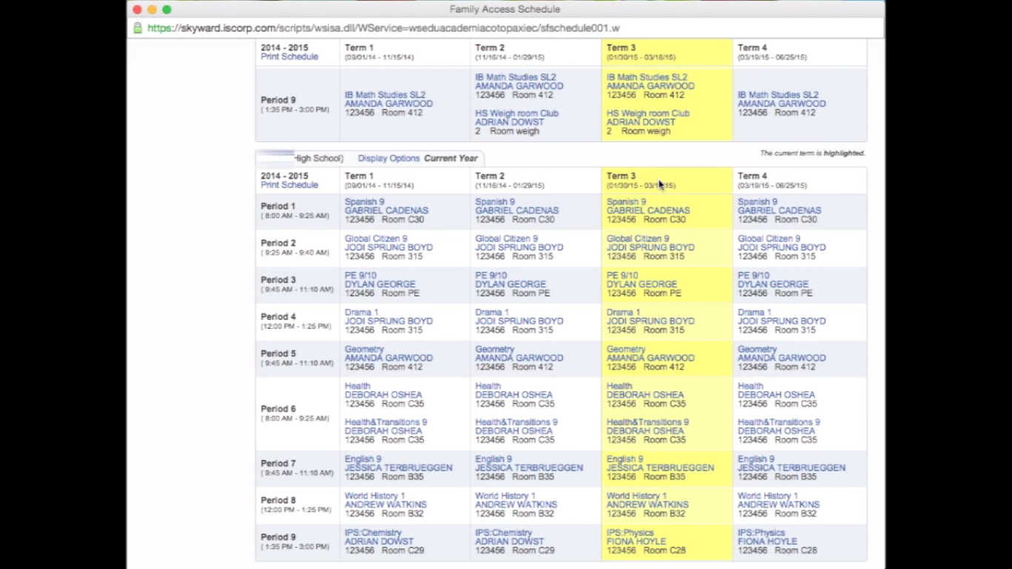

Slide 27
Skyward Parent Access
Understanding skylert

Slide 28
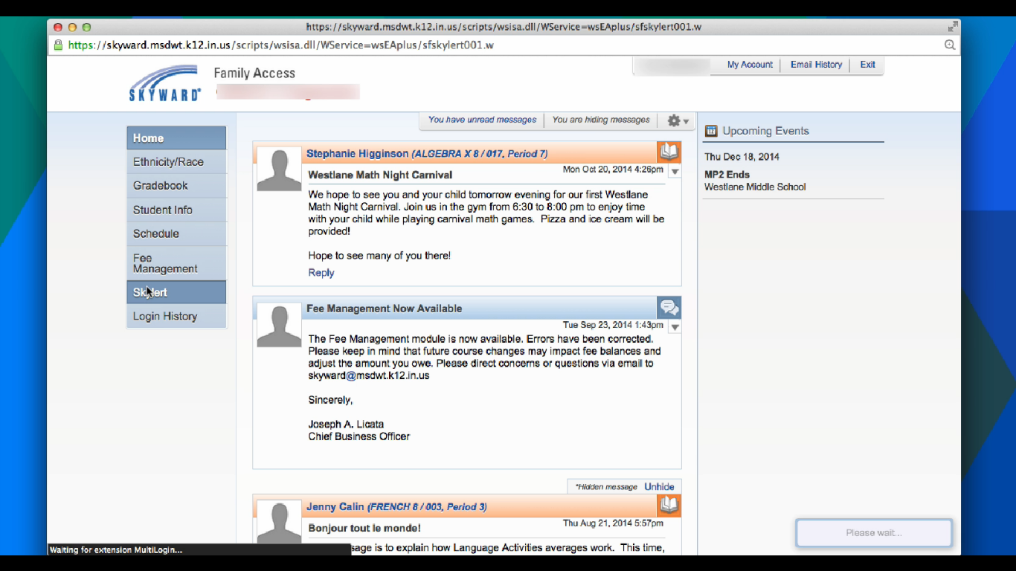

Slide 29
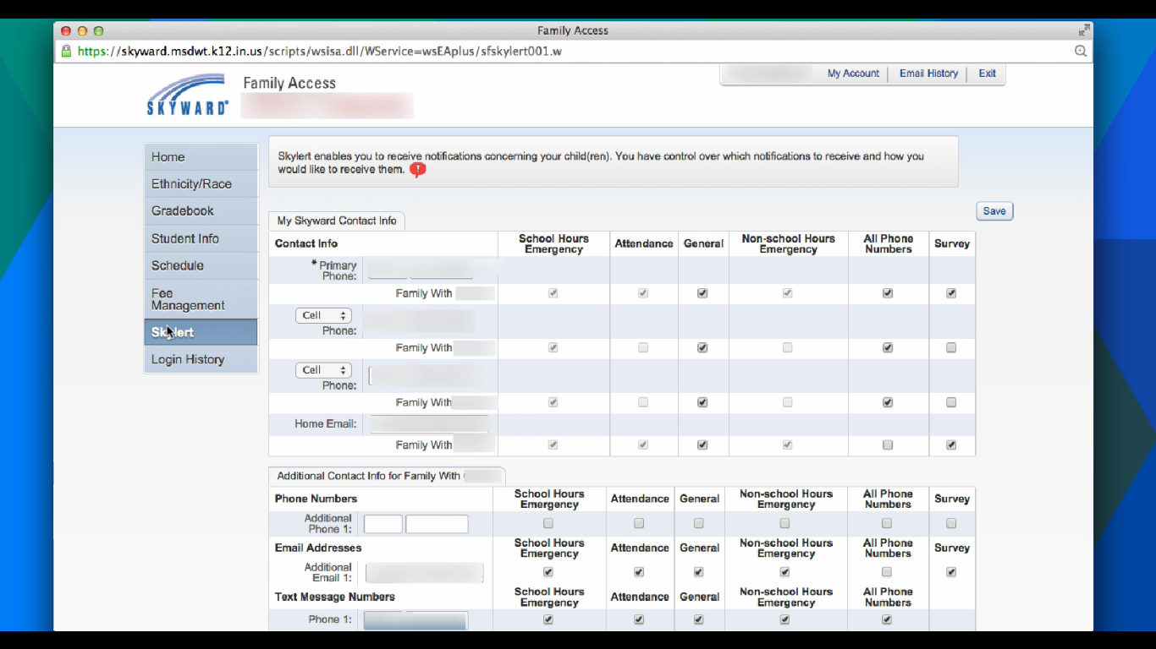

Slide 30
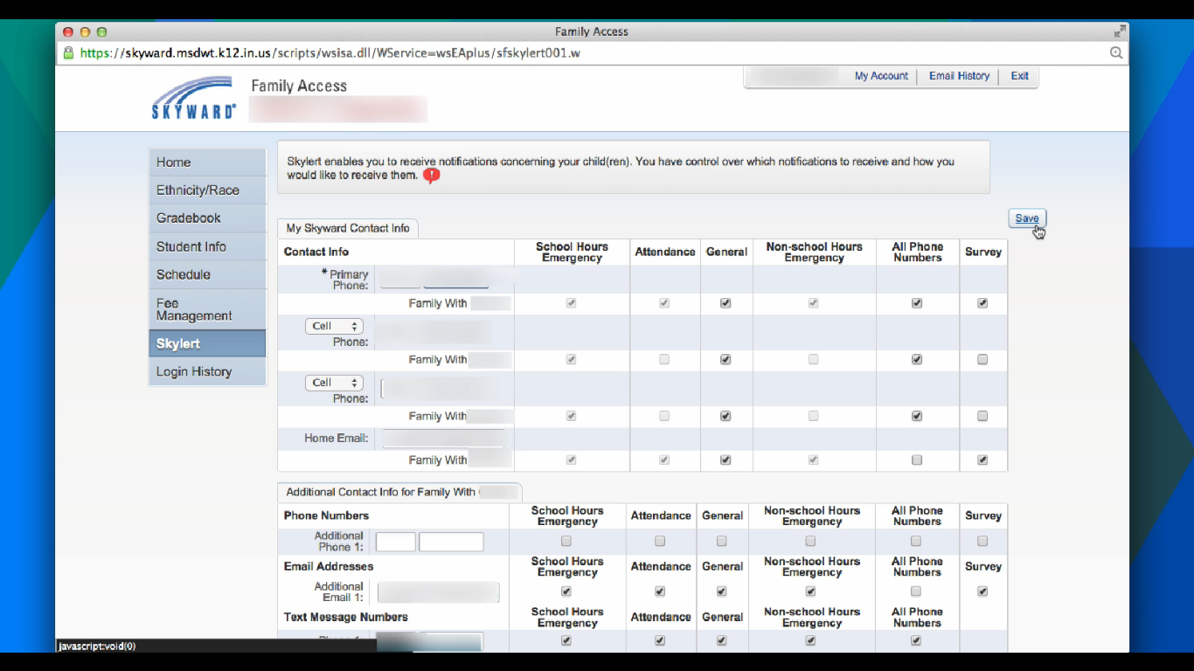

Slide 31
Resources
MSDWT Skyward site for parents
http://sites.msdwt.k12.in.us/skyward/category/parents/
John Feeney’s Classroom Website and Resources
http://sites.msdwt.k12.in.us/jfeeney/
If you have questions or concerns about Skyward, please email us at skyward@msdwt.k12.in.us

Slide 32
Survey Feedback
Please take a moment to complete the survey. A member of our staff will gather this information and respond to you as soon as possible. Thank you again for your help in improving your child’s educational experience.
https://www.surveymonkey.com/s/L8L678N

Slide 33
Thanks for coming!!!
Contact information
John Feeney
jfeeney@msdwt.k12.in.us
317-259-5401 ext.: 21123
Twitter: @Eastwoodfeeney

