Slide 1
Understanding Search Engines
What Is The Web?
Web Search Lesson Plan
Module A1

Slide 2

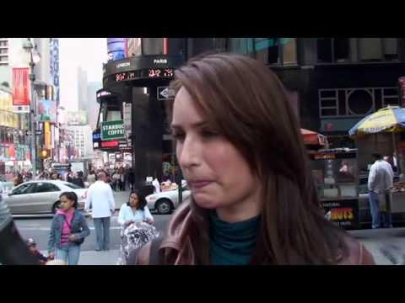
Word Soup
There are a lot of names and terms associated with the internet, the web, browsers, and search engines. Sorting them out can get confusing!
Google Confidential and Proprietary

Slide 3

What is the Internet?
The internet is a global network of computers. It is millions of computers around the world, all connected.
People often think of the internet as a cloud in space. In reality, every computer in the "inter-network", or internet, is connected by actual wires -- ethernet cables, phone lines, and fiber optic wiring on the ocean floor!
Google Confidential and Proprietary

Slide 4
What is the Web?
People often use the words "the internet" and "the web" interchangeably. Is there a difference?
The World Wide Web is just one part of the internet. The internet also includes e-mail, instant messaging, multiplayer gaming, and FTP (peer-to-peer file sharing).
Google Confidential and Proprietary

Slide 5
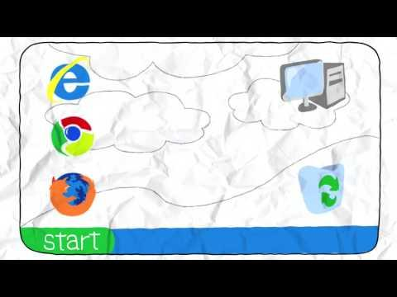
What is a Browser?
A browser is a tool to help you access the World Wide Web. Check it out!
Google Confidential and Proprietary

Slide 6
Websites vs. Webpages
A website is a collection of webpages that belong to one domain or owner.
A webpage is a single document (which can include images, videos, charts, etc) viewable through a web browser.
For example, www.sandiegozoo.org is a website for the San Diego Zoo. "Hours & Directions" is one webpage on the website.
Google Confidential and Proprietary

Slide 7
What is a Web Address?
A web address is the identifying address for a file, or webpage, on the internet. Typing a web address into the browser bar, or address bar, allows you to access this file on the internet. Another word for "web address" is URL.
An example of a web address is http://www.google.com.
Google Confidential and Proprietary

Slide 8
What is a Search Engine?
A search engine is a program to help you find webpages on the internet.
Search engines do not search the whole web, but only an index of the web.
Some examples of search engines include Google, Bing, Yahoo, and Ask.
Google Confidential and Proprietary

Slide 9
Deep Web vs. Visible Web
When you use a search engine, you only have access to the visible web -- the part of the web your search engine has indexed.
The entire web is much larger than any one search engine's index. It is estimated that the deep web is over 500 times the size of the visible web!
The deep web includes webpages that are not linked to by other pages, password-protected sites, and private databases (such as library catalogs).
Google Confidential and Proprietary

Slide 10

Putting It All Together
Can you remember what each of these words mean? How are these terms different? How are they related?
• The Internet
• The Web
• Browser
• Search Engine
• Website vs. Webpage
• Web Address (URL)
• Deep Web vs. Visible Web
Source: http://www.cashedge.com/pressRoom/news_070104_bst.html
Google Confidential and Proprietary

Slide 11
Understanding Search Engines
Google Landing
Web Search Lesson Plan
Module A2
Notes:
Inquiry question: How does search work on the web?
Students will identify the basic parts of a web search engine search page.
Students will learn to "read" a web search results page.
Today we will learn the basic of how to use a search engine. We will be using Google.

Slide 12
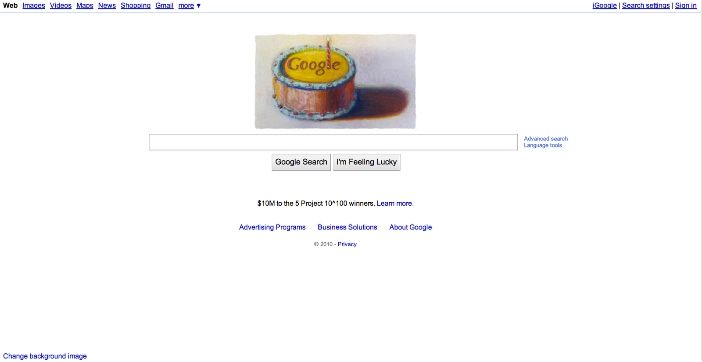

Homepage
Notes:
This is what the homepage looks like, you find it by entering google.com in the address bar of your browser.

Slide 13
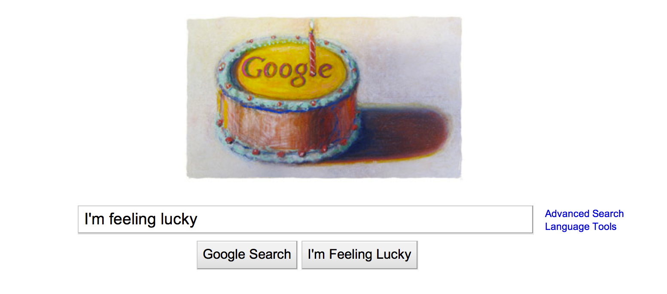
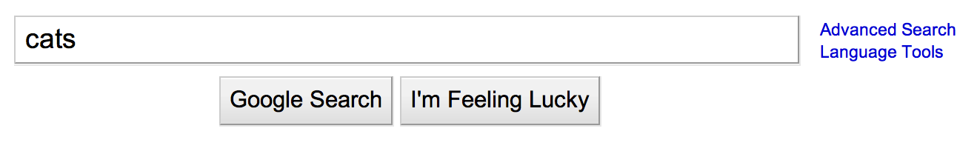
Say What You Want
A "query" is the word or phrase you search for in Google.
Enter your query here
Click this button
or hit "enter"
What happened?
Notes:
When you want to find information with Google, you click in the search box on the homepage.
You can tell you are there when you see your cursor blinking in the box.
Then, type the words you want to find into the search box like this. (Demonstrate in an open browser, if available)
When you are done, you can either click the button here that says "Google Search," or you can simply hit the "enter" button on your keyboard.
(You can open a browser such as Chrome, Firefox, or Safari and demonstrate where students might type a search into the browser's toolbar. In Chrome, you type both queries and addresses into the address bar. In other browsers, the long bar across the top of the browser is for entering addresses, and the smaller box--often in the upper right-hand corner--is for entering queries.)

Slide 14

Another Search Option
Try clicking "I'm Feeling Lucky."
What happened?
Notes:
Have students enter a simple query try the "I'm Feeling Lucky" button. Ask them to observe what happens.
Possible answer: I'm Feeling Lucky does not take me to search results, but takes me directly to the page that Google would give as my first result to the query I entered.

Slide 15
Different Search Tools
Have you used these?
Notes:
If you are looking for something that is not necessarily on a typical web page, you might want to click on one of these links and use one of Google's special search tools.
From here, you can go directly into Google Images, Google Books, etc. We'll talk about these tools in a later lesson.

Slide 16
Advanced Search
Visit the Advanced Search page. Enter a search using several of the search options offered there.
What do you notice?
Notes:
Show students the link to the Advanced search page, and take a quick look at the advanced search box. Together or individually, try using several of the boxes to run a more complex search.

Slide 17
Language Tools
Visit the Language Tools page and see what the different sections of the page do.
Try the Translate Search section. Visit Google in another country.
Where did you go?
Notes:
Point out the Languages Tools link on the Google homepage an click through to the Language Tools page.
Features include:
Translated search: search in English, Google translates the search to appropriate languages, translates results back into English, and gives them to you.
Translate text: Enter a phrase or more, and Google will translate it into the language you chose.
Translate a webpage: Give the web address of a page, and have the contents translated into the language of your choice.
Use the Google interface in your language: Operate Google in another language--but beware of changing it to something that you can't read so you can't find the link to change it back to English!
Visit Google's site in your local domain: Visit Google's search page for Japan, Peru, and over 180 different locales!
Together or individually, try translating a word or phrase, and click through to another country's Google homepage.

Slide 18
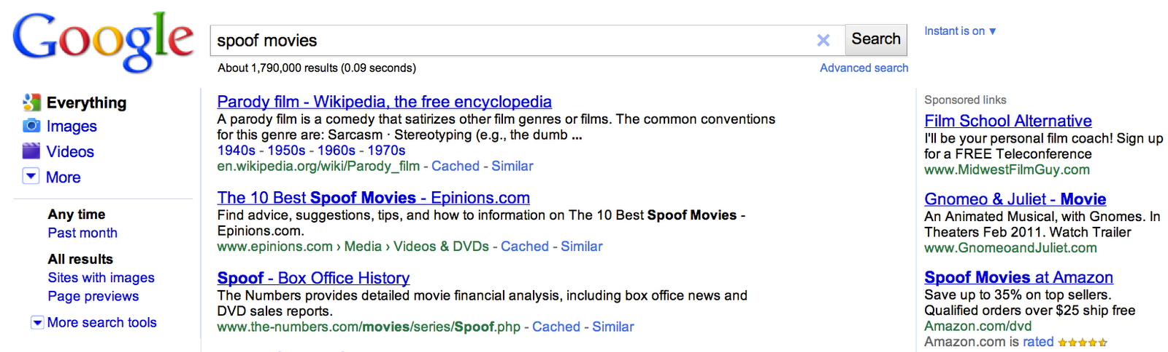
The Search Engine Results Page
Search bar
Left panel
Organic (natural) search results
Sponsored links (ads)
Notes:
Now that you have run a search, you need to understand how the search results page is laid out.
Introduce:
search bar
left panel (the subject of later lessons)
organic search results
sponsored links (ads)
As you click, each of these sections will be highlighted, and the next click will show the section's name.

Slide 19

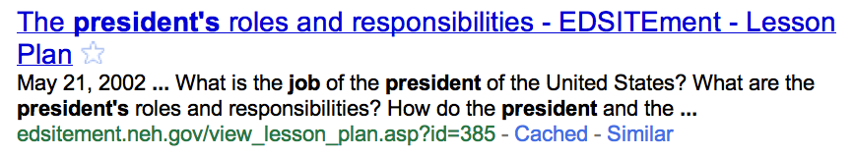



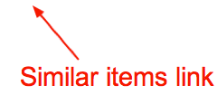
Reading Individual Search Results
Notes:
(1)
The first thing you see is the title.
The title for the page is usually decided by the person who created it.
Here, notice that the title tells us both the name of the page, "The Pesident's Job," and the name of the website from which it comes, "Scholastic.com."
(click)
(2)
The information in black underneath the title is called the snippet.
The snippet gives you a sense of what you will find on the page, and what it has to do with the search you entered.
This description was written by the website's author to help you understand what the page is about. Sometimes, Google shows you where your search term appears on the page, with a few words surrounding it to give you a sense of the context in which it appears.
(click)
(3)
Below the snippet, in green, is the web address. It is the address for the webpage that you will visit if you click on this result.
(click)
(4)
The cached link shows you exactly what this web page looked like when Google last visited it.
If you click on the cached link, you will see a copy of the page as it existed at that time.
This cached link is particularly helpful if the webpage has changed very recently and the information you want is no longer there.
You can just click on the cached link and see what it was that Google found the last time we visited the page.
You can also use the cached link if the page you want to visit is not functioning, or has been removed.
(click)
(5)
Finally, if you find that this page does a good job meeting your needs, you can click on the similar items link to find more pages that have similar content.

Slide 20
Give It a Try!
If you had a website, what would a search engine show about your site?
Write a fictional search result, complete with title, snippet, web address, and similar links.
Notes:
"Snippet" a fictional web site - Students write up search results, like they saw in [Slide #11], of a website about themselves or interview a class member and write up search results about a fictional web page a class member might have. Questions to ask: If they had a web site, what would a search engine show about their site? Include: title, snippet, URL and similar pages. Share student created fictional search results with class to determine understanding of search results and what they mean.

Slide 21
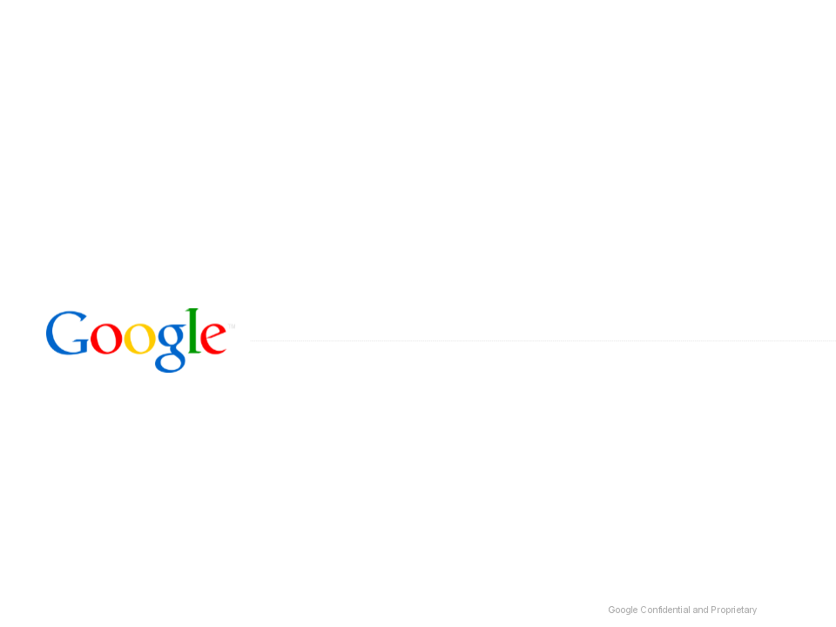

Search Techniques & Strategies
Which Link Should I Follow?
Web Search Lesson Plan
Module B1
Notes:
Inquiry questions: Which link should I follow? Which search result has what I need?
Students will learn to understand what the different parts of search results suggest about the content of the pages they offer.
Students will learn to interpret these results in order to pick the best sources without reading every page.

Slide 22
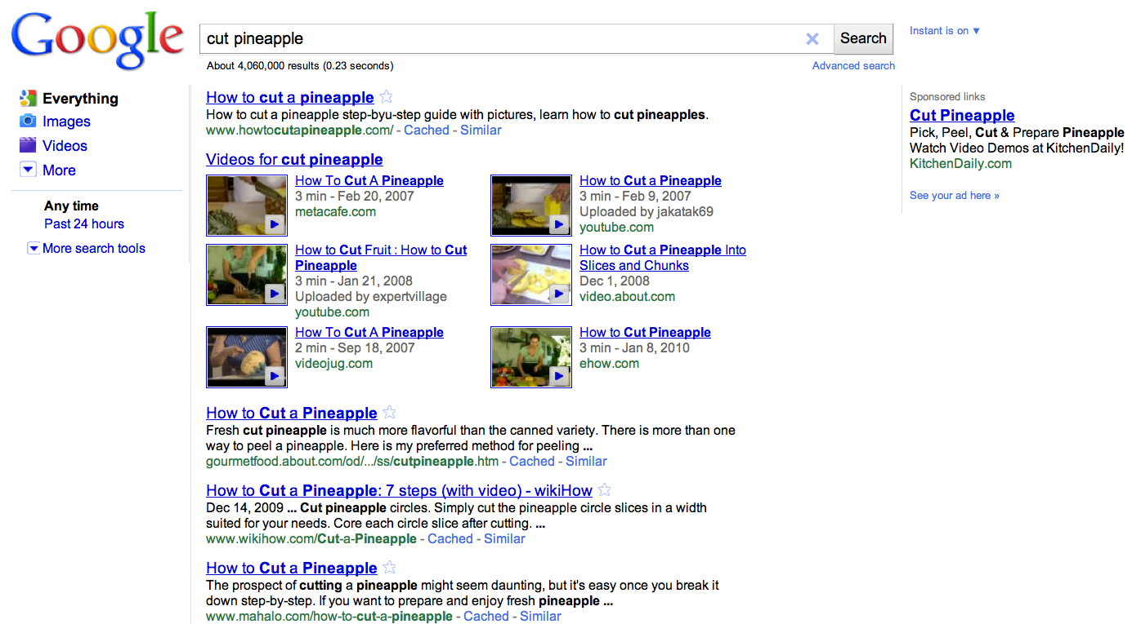
Choosing a Link
Does it matter which link you chose here?
Notes:
The teacher explains:
"If you were cutting up a pineapple for the first time, how would you learn to do it?"
Students guess how to search and anticipate how to read the search results.
For example, the query [cut pineapple] brings back a full screen of videos that show exactly how to do that successfully.

Slide 23
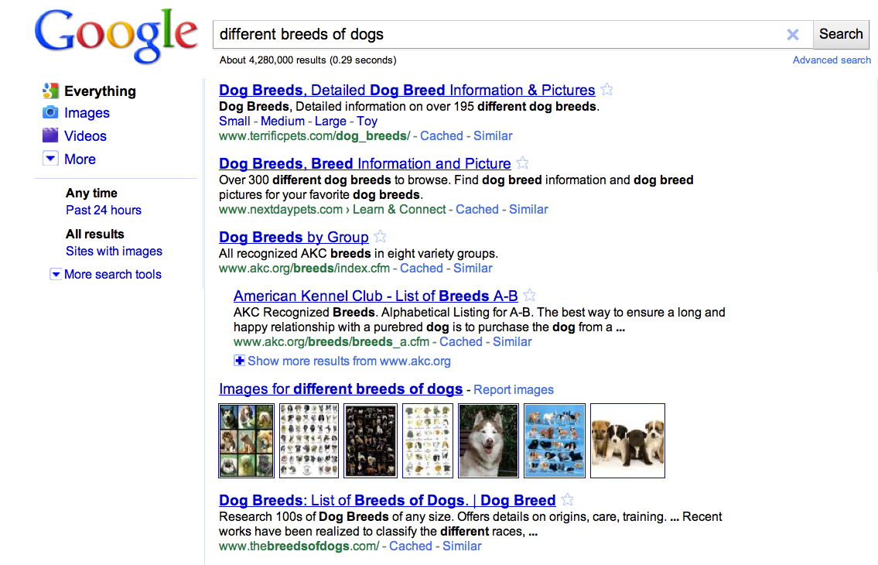
Link Choice Can Matter
Would link choice make a difference here?
Notes:
Then teacher explains:
“Now, let’s say you want to get a pet dog, but you think you want a pure-breed so you can compete in dog shows. If you search for what different breeds of dogs there are, how do you pick which page to visit?”
Brings back pages:
snippets indicate various numbers of types of breeds (one indicates “over 195,” another “over 300”)
middle of the page is the American Kennel Club, which speaks of “recognized” breeds
Ask what language indicates about why the website owner is talking about different breeds of dogs.
Alternatively, the teacher could have a search page open and take student guesses, but do not click on the links.

Slide 24
Give It a Try!
You are doing your homework on the early days of our country.
Which of these searches find a screen full of pretty helpful results, and where do you have to be more choosy?
[colonial life]
[american revolution]
[treaty of paris]

Slide 25
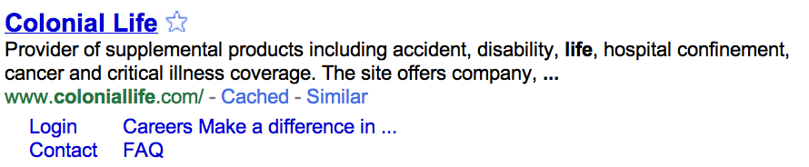
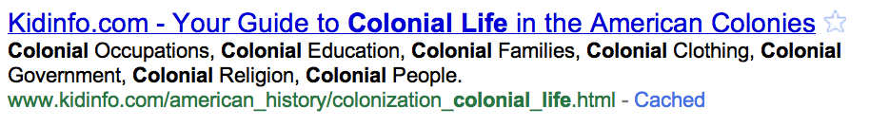
Think About What You See
What clues tell you if these results are about life in the American Colonies?
Notes:
The first step in picking a link is thinking about what you see.
Look at the two search results.
Discuss what clues students see that help them decide which would be good to click.

Slide 26
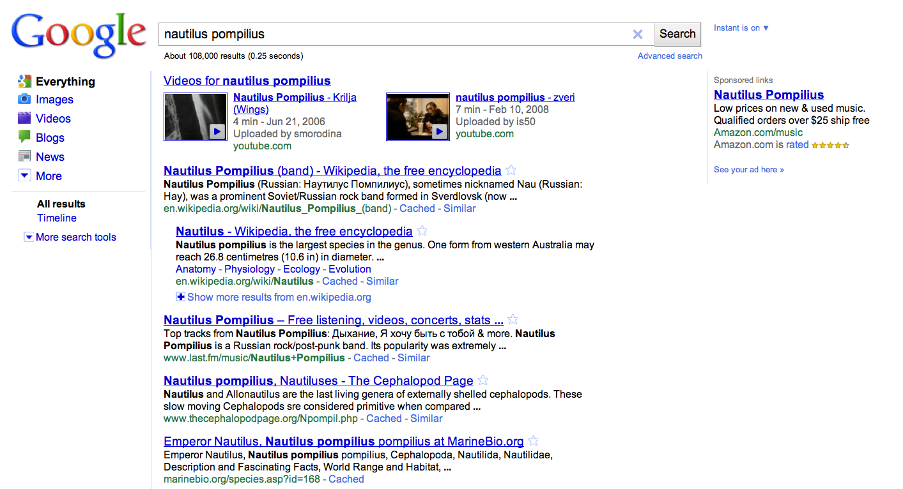
The Anatomy of a Search Results Page
What are these parts called?
Notes:
Discussion questions:
*How does Google search work? What do these search features mean?
*How can they help you decide which link to follow?
*Search results
Possible Answers:
These are the organic search results. The results are not influenced by sponsored links. Google does not sell results rank for search results. Organic search results and sponsored link results work from different and separate servers.
*Title
Possible Answers:
The name of the specific page you would visit if you clicked on that link.
*Snippet
Possible Answers:
A description of the content that you will find if you click on that search result. It may be written as a description, or it may be segments of the text of the page that show the words from your query.
*Web address
Possible Answers:
Also called a URL. The market for the unique location that webpage occupies on the Internet.
*Sponsored links
Possible Answers:
Google allows for ads with specific guidelines. Ads must be relevant to the search, not be distracting, and labeled clearly as "Sponsored Links". Google doesn't sell search results.
*Left Panel
Possible Answers:
The column of links down the left-hand side of the results screen. It suggests ways you might want to filter your results, and can be opened up to allow you to make a number of choices regarding how your results can be filtered and sorted.

Slide 27
The Anatomy of a Search Results Page
1
6
5
2
1. Search Result
2. Title
3. Snippet
4. Web Address
5. Sponsored Link (Ad)
6. Left Panel
4
3

Slide 28
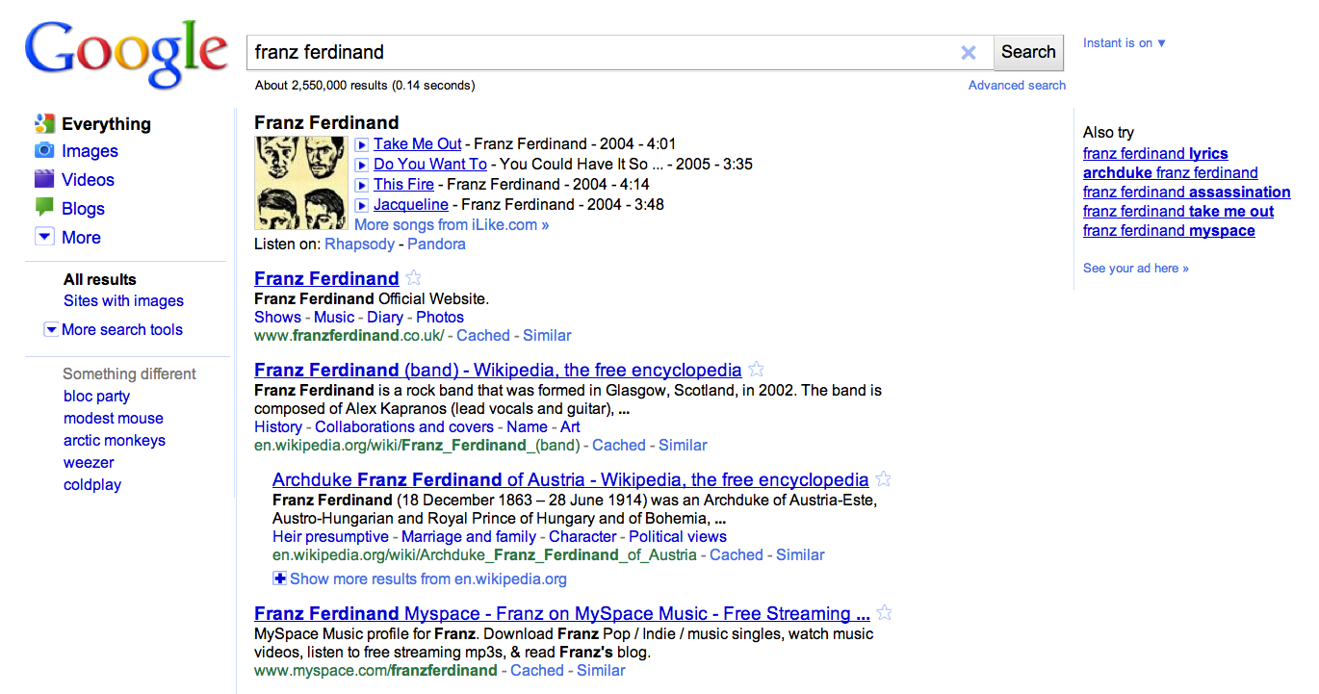
Ranking Results
How does Google's understanding of what I want affect the order of my search results?
Notes:
Google ranks results, showing you those that it thinks best fit your query first.
Google uses a specific calculation to determine both which results and where results appear on the search results page.
This calculation is based on similar (relevant) pages and web pages with hyperlinks to those pages.
So, the more popular and relevant a particular website, the more likely it will be ranked higher and indexed on the results page.
Google search is constantly being revised to make sure the most useful results appear on top.
Funny story: Lead singer of Franz Ferdinand, Alex Kapranos, gave interview.
He once said he would know if his band had "made it" when they occupied the first place in the search results!
Have they made it?

Slide 29

Predicting the Best Source
Tips for Finding What You Want

Slide 30

Tips for Understanding Web Addresses
1
Have I heard of the domain?
For example: nytimes.com, lostagoodnews.com
2
What type of domain is it?
For example: .com, .edu, .gov, .ru, .info, etc.
3
Is there a symbol (% or ~) or name, showing it is a personal page?
For example: %, ~, dchen, member, user
4
Is the domain name from a personal page hosting website?
For example: Homestead.com, Geocities.com, Tripod.com
5
Does the address tell what kind of file it is?
For example: pdf, xls, jpg

Slide 31


Chose the Best Result
What am I looking for?
What do I really want? What do I think it will look like? What kind of site do I think it will be on?
Do the words I see match my needs?
Do the snippet and title use the words I looked for in the same way I do? Are there other words that tell me it is about something else?
Go to the
next result
What does the web address tell me?
Which of these keywords are common or general words? Which would be more specific? Are there better words I could use?
Go to the next result
What kind of results am I looking for?
Do I want a definition, a database, a list, a map, an image, a video, or something else?
Do I want a presentation, a spreadsheet, or something else?
Go to the
next result
Click!
Remember: look at a full screen of results before deciding!

Slide 32
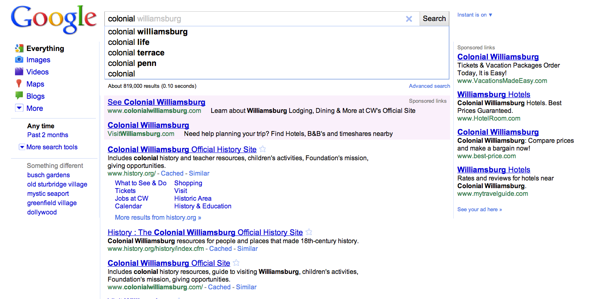
Working with Instant Search
Notes:
Instant Search
Type slowly:
[colonial life in america]
Let students observe how results change--not relevant, relevant, not relevant, relevant.....

Slide 33
Give It a Try!
What can I learn about my results from these web addresses?
www.history.navy.mil/faqs/faq56-1.htm﻿
www.sjsu.edu/faculty/watkins/taiping.htm
britishbattles.homestead.com/eastasia.html
www.redcoat.me.uk/Rev-War.htm
scs.student.virginia.edu/~vjil/PDF/48_249-306.pdf
Try a search and discuss what links you would chose. Give evidence for your results.
Type [walk the plank] into your Google search bar very slowly. What different searches does Google Instant think you are doing while you type?

Slide 34
Features & Operators
Hello Operators
Web Search Lesson Plan
Module C1
Notes:
Inquiry questions:
How can I further refine my searches in order to find more relevant material?
How can I find results that might not be easily found with basic search?
What are the syntaxes associated with advanced search techniques?
In this module, students will learn how to use Google's seven advanced search operators.
Students will be able to conduct advanced searches and determine when each type of operator should be applied.

Slide 35
What is an Operator?
" "
!
%
*
An operator is a symbol that modifies the words or numbers around it.
You already know some operators!
&
+
_
>
( )
#
$
Notes:
Give a brief introduction to operators.
Discuss with students what operators are and how they modify words or numbers around them.
Ask students to provide examples of how certain English and mathematical operators are used to change the meaning of a sentence or phrase.

Slide 36
Google Search Operators
In search, an operator changes your search query -- often with drastic results!
These operators can help you tweak, refine, and narrow your search.
There are seven basic operators in Google Search.
Notes:
Like English or math, Google Search has particular operators that modify a search query.
Tell students they will be introduced to seven advanced operators to use in their searches.

Slide 37
Search Tools
Using Operators to Narrow Your Search

Slide 38
Exclusion (-)
The minus symbol (-) excludes words from your search results.
Try these searches:
[panthers]
[panthers -sports]
What do you notice?
Notes:
Demonstrate advanced operator searches as indicated on the slides.
Conduct the searches on each slide with and without the advanced operator, and ask students to notice and discuss the differences in the search results between these searches.
Encourage students to offer any other possible searches that might make use of each operator.
Ask students to follow along on computers if possible.

Slide 39
Inclusion (+)
The plus symbol (+) makes sure the word it precedes is used exactly as you entered it.
Try these searches:
[ball]
[+ball]
What do you notice?

Slide 40
Similar Words (~)
The tilde symbol (~) includes similar words in your search results.
Try these searches:
[food store]
[~food ~store]
What do you notice?

Slide 41
Multiple Words (OR)
The boolean "or" (OR) includes one, the other, or both words in your search results.
Try these searches:
[curl straighten hair]
[curl OR straighten hair]
What do you notice?

Slide 42
Number Range (..)
The dot-dot symbol (..) includes a range of numbers in your search results.
Try these searches:
[academy awards 1965]
[academy awards 1965..1973]
What do you notice?

Slide 43
Fill-in-the-Blank (*)
The star or asterisk symbol (*) leaves space for a missing word in your search results.
Try these searches:
[dark and night]
[dark and * night]
What do you notice?

Slide 44
Exact Phrase (" ")
Double quotes (" ") include only the exact phrase -- the exact words in the exact order you entered them -- in your search results.
Try these searches:
[alexander bell]
["alexander bell"]
What do you notice?

Slide 45
Putting It All Together
Can you think of particular examples when these search operators could help you?
• Exclusion (-)
• Inclusion (+)
• Similar Words (~)
• Multiple Words (OR)
• Number Range (..)
• Fill-in-the-Blank (*)
• Exact Phrase (" ")
Source: http://www.cashedge.com/pressRoom/news_070104_bst.html
Notes:
Review and recap

Slide 46
This lesson was developed by:
Trent Maverick
Tasha Bergson-Michelson
This lesson is licensed under a Creative Commons Attribution-Share-Alike license. You can change it, transmit it, and show it to other people. Just always give credit to Google.com ("Attribution"), and make sure that any works you make based on these lessons are also under the same Creative Commons Attribution-Share-Alike license ("Share-Alike").
http://creativecommons.org/licenses/by-sa/3.0/legalcode.

